Slide 1
Escape from New York
The disappearance of the traditional dialect features of NYC English
Gregory R. Guy
New York University
American Dialect Society 2016

Slide 2
Labov’s study: 1963-4
The Social Stratification of English in New York City (1966) described the speech of a social cross section of New Yorkers in Manhattan’s Lower East Side (LES).
Several phonological features were prominent in the speech of the day

Slide 3
Ethnic make-up of LES- 1960
 | LES
White | 63%
Jewish | 27%
Italian | 11%
Other white | 25%
African-American | 26%
Hispanic | 8%
Asian-American | 3%

Slide 4
Six variables of NYCE
coda /r/: beer, hair, car, fourth
nuclear /r/: worth, bird
tense /æ/: man, bad, half vs. hang, cat, have
raised BOUGHT: coffee, talk
TH-stopping: think/tink
DH-stopping: them/dem

Slide 5
r-lessness
NYCE was an ‘r-less’ dialect (vocalized or deleted coda /r/), like the Coastal South and Eastern New England in the USA, and Southern British English, Australia and New Zealand: beer, hair, car
Nuclear /r/ (in bird, worth, etc.) was variably dipthongal (stereotyped as boid, woid)

Slide 6
Stratification of (r)
r-lessness was not socially differentiated prior to approximately World War II.
e.g., Franklin Roosevelt, US President 1932-1945, was r-less. He was from an old patrician NY family, descended from the original Dutch settlers of ‘New Amsterdam’
https://www.youtube.com/watch?v=S3RHnKYNvx8

Slide 7
Stratification of (r): Change from above
By the time of Labov’s study (27 years after FDR speech) (r) has become social stratified; r-lessness is stigmatized.
Higher status people have begun to pronounce coda (r)
Style shifting: all social classes use (r) in careful styles

Slide 8
Class Stratification of (r) in 1963

Slide 9
Stratification of (r) in NYC department stores

Slide 10
(r) in NYC department stores: Age grading in 1963

Slide 11
/r/ - Change in real time

Slide 12
(r) in NYC department stores: Age grading in 2008 (Guy et al.)

Slide 13
(r) in NYC department stores at 22 year intervals

Slide 14
Labov’s account: early stage change from above

Slide 15
(r) as nucleus - diphthongization

Slide 16
Diphthongal (r) in apparent time - 1963

Slide 17
(TH)-stopping Social stratification in 1963

Slide 18
(DH)-stopping – 1963

Slide 19
TH/DH in apparent time – 1963 Advancing from below, correction from above

Slide 20
(TH) in 1963 – still increasing

Slide 21
(oh) – stalled or reversing in 1963

Slide 22
(oh) in 1963: inflection point?

Slide 23
BOUGHT in 2010 (Becker)

Slide 24
(aeh) in apparent time: advancing from below, correction from above

Slide 25
(æh) raising in 1963: advancing, with correction from above

Slide 26
/æ/ - split, classic NYCE system (Becker 2010)

Slide 27
/æ/ split – nasal system (Becker 2010)

Slide 28
/æ/ realignment – height (F1) LES whites in Becker 2010

Slide 29
/æ/ realignment – backing (F2) LES whites in 2010 (Becker)

Slide 30
Summary
Labov’s study in 1963 occurred around the time of a major turning point in NYCE; the features that had characterized the city dialect stopped advancing, and started to recede.
Likely motivation is the stigma associated with NYCE; NYers became more aware of it (perhaps beginning c. WW II)
A major facilitating factor is the decline of the native-English speaking population in NYC

Slide 31
How NYCE speakers are stigmatized : Two examples
Dennis, a Jewish NYer from Far Rockaway, Brooklyn
goes to university in Boston, lives w/ 4 non-NYC roommates; we all mocked his accent endlessly
Paula, born in Brooklyn, raised in Long Island suburb of NYC
goes to university in Grinnell, Iowa.
people mock her ‘Long Island’ accent from day one
she resolves to never again be dialectally recognizable

Slide 32
Paula’s English today
completely r-full
except certain lexical items, e.g. shortly
low /æ/, some tensing before nasals
hypercorrected BOUGHT vowel
pronounces many BOUGHT words with /a/
others hear her name as ‘Polly’

Slide 33
Why is NYCE stigmatized?
The largest, most economically dominant city in a country is usually the model for the national standard; e.g.
London English
Parisian French
Beijing Mandarin
Spanish of Madrid, Bogota, Buenos Aires, Mex. City
Moscow/St. Petersburg Russian
Tehrani Farsi

Slide 34
Likely historical explanation
Originally settled by Dutch in 1624, as ‘New Amsterdam’
Taken over by English in 1664
Established Dutch population gradually learn English
Relatively small; at the time of the American Revolution, NY was only the 7th largest state in population

Slide 35
Growth through immigration
New York experiences explosive growth via immigration, beginning with the construction of the Erie Canal in 1825
Erie Canal provided the pathway to the Great Lakes region, attracts millions of European immigrants; the vast majority speak LOTES
NYC is the port of access
Average annual population growth leaps from 2.5% during 1810s to over 5% during 1820s

Slide 37
Erie Canal – pathway to the American interior

Slide 38
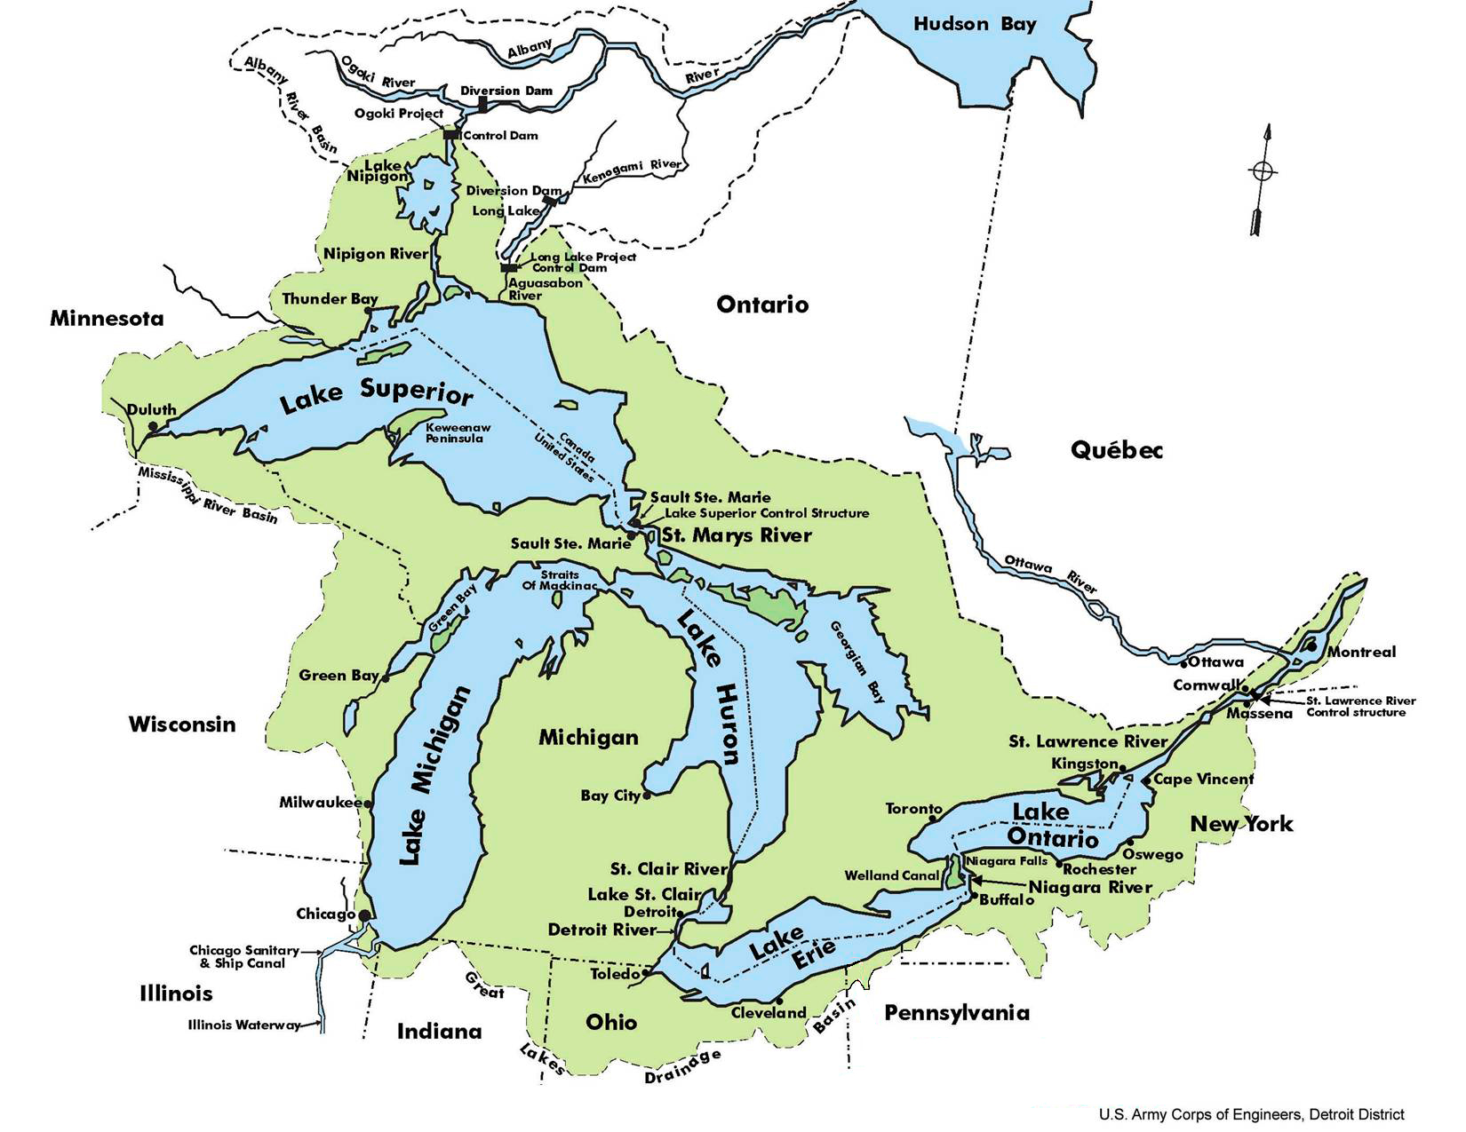

Slide 39
ANAE – Great Lakes dialect region

Slide 40
Early attitudes towards NYCE
First seen as English as spoken by Dutchmen (17-18th C)
Then seen as English spoken by foreign immigrants (19th-20th C)
Regional rivalries with the two big cities of colonial America, Philadelphia and Boston
Philadelphia was largest city in the 1760s-70s, site of continental congress, first capital of the USA

Slide 41
Perceptions of NYCE
What did Bostonians and Philadelphians think of New York and its speech in the 19th C.?
It was an upstart, surpassing them in size and influence because of the influx of immigrants
Not a place, or a dialect, to be admired
Always seen as a city of foreigners with accents

Slide 42
New York City Demographics 2013
2013 | New York City | Metropolitan Area (SMSA)
Population | 8.49M | 19.75M
White (not Hispanic) | 33% | 58%
African American | 26% | 16%
Hispanic | 29% | 18%
Asian | 13% | 7%
Foreign born | 37% | 22%
speak LOTE at home | 49% | 30%
not African-American, speak English at home | 26% | 54%

Slide 43
So how do all those ethnic groups use English?
Some recent studies
Becker 2010 LES
Newlin-Lukowicz 2014 Polish New Yorkers
Wong 2014 Chinese New Yorkers
Shousterman 2014 English in Spanish Harlem
Bauman 2015 Asian Sorority in North New Jersey

Slide 44
Polish speakers of English in New York City (Newlin-Lukowicz 2014)
Variable usage of NYCE features:
•short-a tensing
•cot-caught distinction
•TH-stopping

Slide 45
Three clusters of speakers from hierarchical cluster analysis
Ethnic orientation to…
Poland: Strong ties to Poland and low involvement in NYC Polish community
Polish New York: Strong ties to Poland and high local involvement in NYC
America: Weak ties to Poland

Slide 46
Ethnic orientation: Poland

Slide 47
Orientation: Polish New York

Slide 48
Orientation: America

Slide 49
ABC NYers: BOUGHT in apparent time (Wong 2014)

Slide 50
ABCNY: Older speakers differ by ethnic orientation

Slide 51
Ethnic identification shifts with expansion of Chinese population
For older ABC NYers, using NYC raised BOUGHT was a marker of an ‘American’ ethnic orientation.
Chinese were a much smaller proportion of the NYC population before c. 1975-80
Younger ABC NYers grew up with many more Chinese around, and fewer white NYers.
For them, BOUGHT is not an ethnic marker; most speakers have less access to white NYers, and/or “dissociate themselves from a mainstream white NYC persona”

Slide 52
George, b.1949: growing up in NYC in the 1950s

Slide 53
Winnie, b. 1940: life in the LES today

Slide 54
Prosody as ethnic marker
Bauman 2015 finds Asian American young women – all L1 English speakers, some bilingual in parent’s language – use lower PVI prosody (more syllable timed) than non-Asian English speakers.
Shousterman 2014 finds Hispanic NYers, monolingual in English, use lower PVI prosody

Slide 55
PVI values for several ethnolects (Bauman 2015)

Slide 56
Conclusions
NYCE is a ‘swamp of negative prestige’
Traditional NYCE features are disappearing in the city, for several reasons
Native NYers are avoiding the stigma, since coming into greater contact with outsiders
Ethnic NYers have avoided NYCE features to mark ethnic difference
The pool of native NYCE speakers may now be too small to perpetuate the dialect

Slide 57
Danke Grazie
Dziekuje Arigato
Obrigado
Merci Gracias
Thank you!
(…but no t’anks ;-)
Comments and requests for copies of this powerpoint:
gregory.guy@nyu.edu

Slide 58
(aeh) by ethnicity and age

Slide 59
(æh) height in 1963 – another inflection point?

Slide 60
Polish-English contact
Polish phonology conflicts with English on all these variables:
no tense/lax distinction
only one low back vowel phoneme
no interdental fricative
More Polish-influenced English could have smaller low-back and short-a distinctions, and higher rates of TH-stopping

Slide 61
TH-stopping

Slide 62
George, b.1949: growing up in NYC in the 1950s, vs. today

