Slide 1
Iconicity and nonlocality as ethnolectal markers
Ethnolects in New York City English
Gregory R. Guy
New York University
New developments in the study of migration and ethnolectal variation
Meertens Instituut, 2016

Slide 2
Roadmap, contents
History of NYC ethnolinguistic groups
Background: characteristics of NYCE
NYCE in 1963: Labov’s study
Current ethnic makeup
Iconic variables indexing ethnicity
Avoidance of local features indexing identity

Slide 3
New York City: Bilingual origins
Founded by the Dutch in 1624, as ‘New Amsterdam’
Taken over by the English in 1664
Dutch residents remain, constitute a significant part of the colonial elite (cf. Roosevelts, Vanderbilts, etc.)
Dutch community undergoes gradual language shift to English

Slide 4
The polyglot metropolis
Major port city: maritime operations drive multilingual contacts through trade and immigration
Explosive growth in the 19th C fueled by massive European immigration

Slide 5
Growth through immigration
New York experiences explosive growth via immigration, beginning with the construction of the Erie Canal in 1818
Erie Canal provided the pathway to the Great Lakes region, attracts millions of European immigrants; the vast majority speak LOTES
NYC is the port of access
Average annual population growth leaps from 2.5% during 1810s to over 5% during 1820s

Slide 7
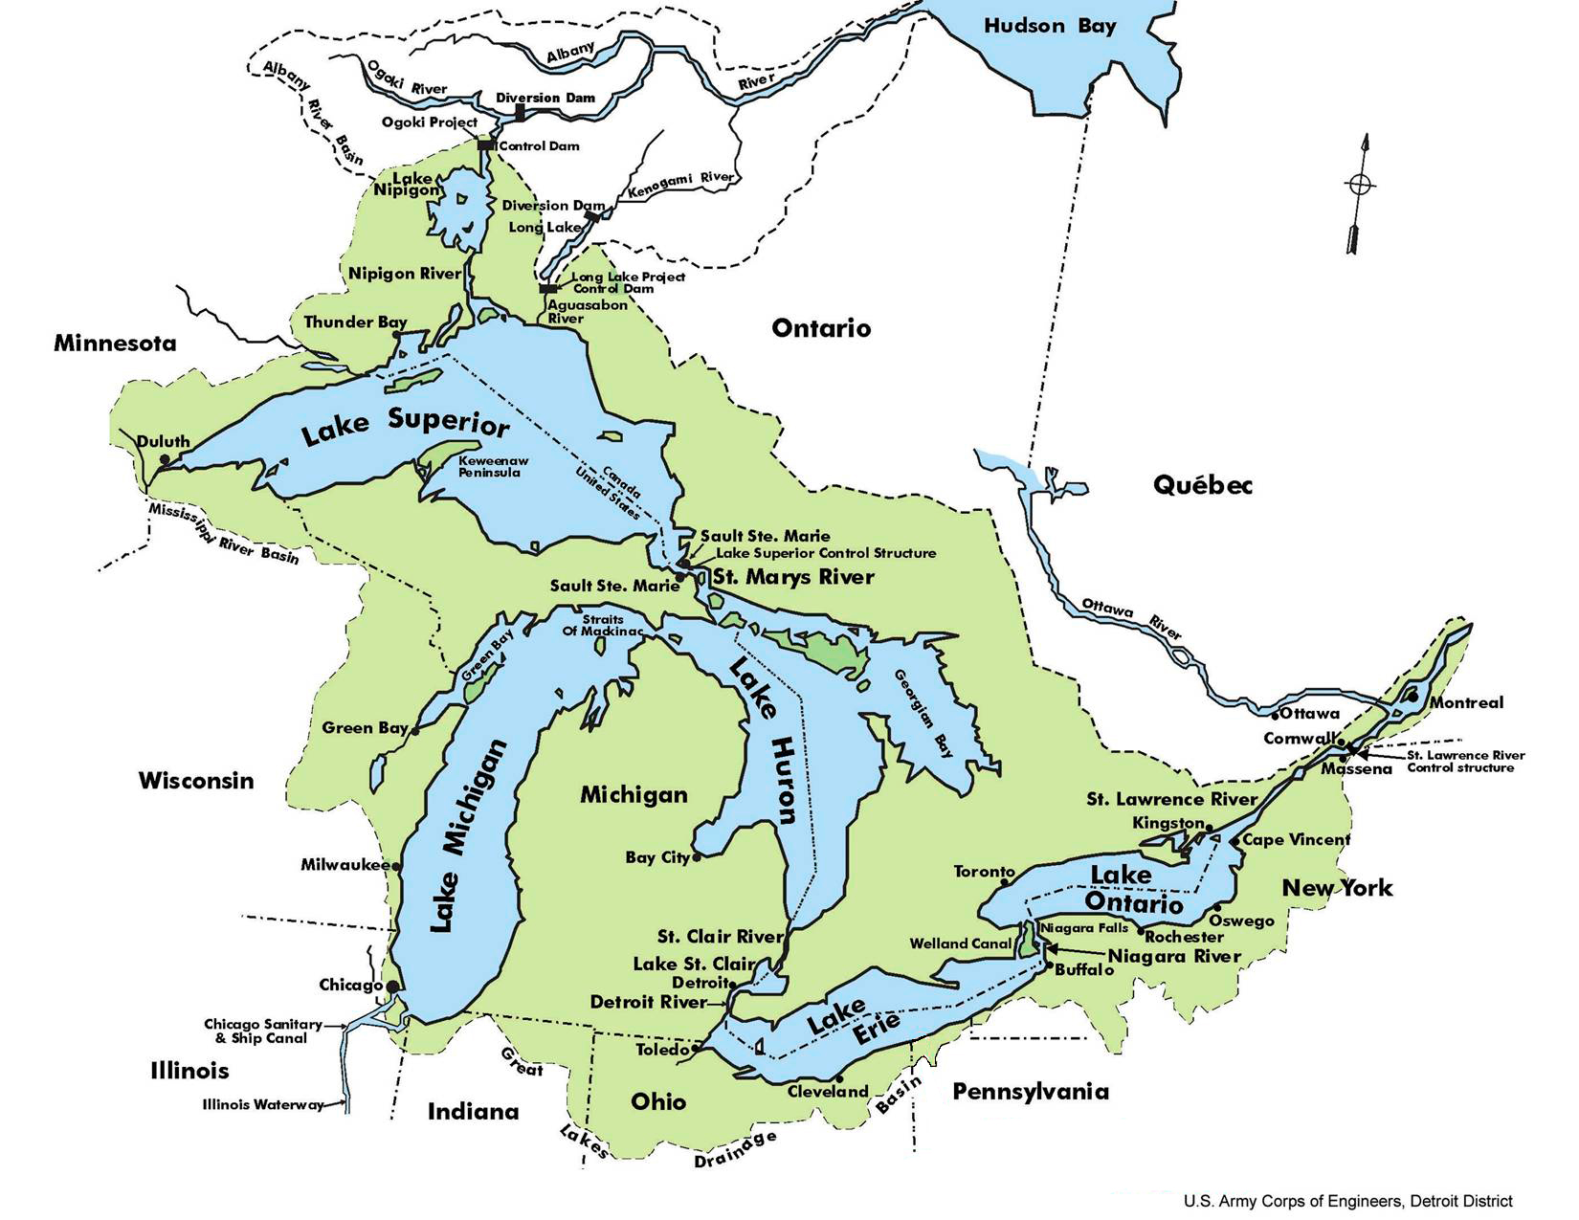

Slide 8
ANAE – Great Lakes dialect region

Slide 10
19th C immigrants
Largest groups
Germans
Irish
Poles
Italians
Swedes
Jews, mostly from Eastern Europe (Russia, Poland, Ukraine)

Slide 11
20th C immigration
Very high immigration rates (>1 million p.a.) until 1920’s
1924 Immigration Act severely restricts inflow (to ca. 200k p.a. in 1920s, <50k p.a in 1930s), establishes nationality quotas
Numbers increase after WW II both legal and illegal (cf. immigration from Mexico)
Substantial migration to NYC from Puerto Rico; as US citizens, PRs are not ‘immigrants’

Slide 12
Language backgrounds in 20th C
Main groups
Early 20th C, mainly southern and eastern European: Italian, southern Slavic languages (e.g. Slovak, Croatian), eastern Slavic languages (Polish, Russian), Hungarian, Yiddish
Beginning in mid-century: significant Hispanic immigration (esp. PR)
Since 1960s – entire world: Caribbean (Cuba, PR, DR, Haiti, Trinidad), Africa, Middle East (Lebanese), South Asia, Central Asia, East Asia (esp. Cantonese and Mandarin, Korean, Vietnamese)

Slide 13
New York City English Labov’s study: 1963-4
The Social Stratification of English in New York City (1966) described the speech of a social cross section of New Yorkers in Manhattan’s Lower East Side (LES).
Considerable ethnic diversity, approximating that of the city as a whole
Several phonological features were prominent in the speech of the day

Slide 14
Ethnic make-up of LES- 1960
 | LES
White | 63%
Jewish | 27%
Italian | 11%
Other white | 25%
African-American | 26%
Hispanic | 8%
Asian-American | 3%

Slide 15
Six variables of NYCE
coda /r/: beer, hair, car, fourth
nuclear /r/: worth, bird
tense /æ/: man, bad, half vs. hang, cat, have
raised BOUGHT: coffee, talk
TH-stopping: think/tink
DH-stopping: them/dem

Slide 16
Social stratification, ethnic differentiation
Labov finds significant social and stylistic stratification of coda and nuclear /r/, and stopping of TH and DH
The ‘local’ variants (r-lessness, stops for TH/DH) are stigmatized: less use by higher status speakers, avoidance in careful styles
He reports some ethnic differences for the vocalic variables and TH/DH

Slide 17
r-lessness
NYCE was an ‘r-less’ dialect (vocalized or deleted coda /r/), like the Coastal South and Eastern New England in the USA, and Southern British English, Australia and New Zealand: beer, hair, car
Nuclear /r/ (in bird, worth, etc.) was variably dipthongal (stereotyped as boid, woid)

Slide 18
Class Stratification of (r) in 1963

Slide 19
(DH)-stopping – 1963

Slide 20
Some changes in progress in 1963
Apparent time evidence shows increases in:
TH stopping
/æ/ raising
In both cases, the highest status groups are reversing direction, avoiding the local feature (i.e. change from below with correction from above)

Slide 21
(TH) in 1963 – increasing

Slide 22
(æh) raising in 1963: advancing, with correction from above

Slide 23
Ethnic differences in 1963 Labov’s results
Italians have, on average
much more raised /æ/
much more TH/DH stopping
Jews have, on average
somewhat higher BOUGHT vowel
African Americans
lower /æ/, BOUGHT

Slide 24
Explanations
Labov speculates that the vocalic differences between Jews and Italians are due to substratum effects
Cites ongoing language contact in both communities, with Yiddish and Italian, respectively
African-Americans reflect the distinctive history of segregation, and internal migration (South to North)

Slide 25
Iconicity and non-locality
Ethnolectal characteristics reflecting the substrate language are iconic: they index ethnic identity by echoing the ‘foreign accent’ of L2 speakers
Yiddish and Italian influences on NYCE vowels?
Ethnolectal characteristics that are different from the matrix majority dialect index non-locality, or social ‘otherness’
African-Americans lack local dialect features

Slide 26
What’s happening today?
Ethnic diversity of NYC has increased dramatically since 1963 (when Labov collected his data)
Ethnolinguistic differentiation also appears to be emerging or increasing
The traditional NYC features are disappearing, probably facilitated by the above trends

Slide 27
New York City Demographics 2013
2013 | New York City | Metropolitan Area (SMSA)
Population | 8.49M | 19.75M
White (not Hispanic) | 33% | 58%
African American | 26% | 16%
Hispanic | 29% | 18%
Asian | 13% | 7%
Foreign born | 37% | 22%
speak LOTE at home | 49% | 30%
not African-American, speak English at home | 26% | 54%

Slide 28
Ethnic make-up of LES- 1960
 | LES
White | 63%
Jewish | 27%
Italian | 11%
Other white | 25%
African-American | 26%
Hispanic | 8%
Asian-American | 3%

Slide 29
So how do all those ethnic groups use English?
Some recent studies
Becker 2010 LES
Newlin-Lukowicz 2014 Polish New Yorkers
Wong 2014 Chinese New Yorkers
Shousterman 2014 English in Spanish Harlem
Bauman 2015 Asian Sorority in North New Jersey

Slide 30
Becker’s results: the Lower East Side
The ethnic make-up has shifted:
African-Americans and Jews still have significant presence
Italian population is much reduced
Latino population now substantial
(Avenue C has streets signs labelling it “Loisada Avenue”, using the NYC Spanish word for ‘Lower East Side’)
Asian population has greatly increased

Slide 31
BOUGHT in 2010 (Becker)
Notes:
For the BOUGHT vowel, the ethnic groups have reversed positions in apparent time. Jews, previously users of the highest articulations of BOUGHT, have changed fastest and are now the lowest. African Americans, previously the lowest, have not shifted and are now the highest. The other white speakers (including the remaining Italians), were previously somewhat lower than the Jews, and have changed fairly rapidly but are now somewhat higher than the Jewish speakers.
And the new arrivals, Latinos and Asians, have

Slide 32
Polish speakers of English in New York City (Newlin-Lukowicz 2014)
Variable usage of NYCE features:
•short-a tensing
•cot-caught distinction
•TH-stopping

Slide 33
Iconicity of the Polish-American variables
Polish lacks the low back vowel distinction. Hence a smaller cot-caught difference is an iconic Polish-English marker.
Polish lacks the tense/lax /æ/ opposition; hence a smaller difference between these allophones is also iconic.
Polish lacks interdental fricatives; TH/DH stopping is therefore ambiguous: it can iconically index Polishness, or index a local NYCE identity

Slide 34
Three clusters of speakers from hierarchical cluster analysis
Ethnic orientation to…
Poland: Strong ties to Poland and low involvement in NYC Polish community
Polish New York: Strong ties to Poland and high local involvement in NYC
America: Weak ties to Poland

Slide 35
Ethnic orientation: Poland

Slide 36
Orientation: Polish New York

Slide 37
Orientation: America

Slide 38
TH-stopping

Slide 39
Polish-Americans: Iconic markers prevail
Vocalic variables: a stronger Polish identity correlates with more iconically Polish articulations
TH/DH stopping: the (iconic) indexical relation to Polishness outweighs the (local) indexical relation to New York-ness.

Slide 40
Wong 2014 studies ‘ABC’s’: American-Born Chinese speakers
Her older speakers show a strong split in BOUGHT pronunciation according to ethnic orientation
More strongly Chinese-identified avoid raised BOUGHT
Weaker ethnic identification is associated with more raised articulations
Younger speakers massively avoid raised BOUGHT
BOUGHT indexes only locality; no substratal or iconic indexicality

Slide 41
ABCNY: Older speakers differ by ethnic orientation

Slide 42
ABC NYers: BOUGHT in apparent time (Wong 2014)

Slide 43
Ethnic identification shifts with expansion of Chinese population
For older ABC NYers, using NYC raised BOUGHT was a marker of an ‘American’ ethnic orientation.
Chinese were a much smaller proportion of the NYC population before c. 1975-80
Younger ABC NYers grew up with many more Chinese around, and fewer white NYers.
These speakers largely seek to “dissociate themselves from a mainstream white NYC persona” (i.e., lowered BOUGHT indexes nonlocality)

Slide 44
George, b.1949: growing up in NYC in the 1950s

Slide 45
Winnie, b. 1940: life in the LES today

Slide 46
Prosody as iconic ethnic marker
Bauman 2015 finds Asian American young women – all L1 English speakers, some bilingual in parent’s language – use lower PVI prosody (more syllable timed) than non-Asian English speakers.
Shousterman 2014 finds Hispanic NYers, monolingual in English, use lower PVI prosody

Slide 47
NYC Hispanic Prosody (Shousterman)
Notes:
NYC Latinos uniformly use a more syllable timed prosody, most likely reflecting Spanish influence. Shousternan’s older speakers have distinctly low PVI values. Her younger speakers are splitting: some are moving slightly towards a more stress-timed, English-like rhythm, some remain with the Latino English prosody.

Slide 48
PVI values for several ethnolects (Bauman 2015)

Slide 49
Iconic nature of prosody: early acquisition correlates with more stress-timed rhythm (Bauman)

Slide 50
The GOAT vowel in Bauman’s data
The GOAT vowel is fronting in many dialects of North American English, especially mid-Atlantic regions including New Jersey.
Bauman’s subjects are members of an Asian-American sorority, specifically focused on sustaining an Asian ethnic identity.
Sorority members use significantly less fronting than other students
No obvious substrate source for backed GOAT
Non-fronting is marking ethnicity by non-locality

Slide 51
Asian-Americans: GOAT fronting
Notes:
The purple triangles are members of the Asian American sorority. The red triangles are other Rutgers students who are not sorority members. The sorority members are resisting the local NJ/NYCE trajectory of /o/ fronting.

Slide 52
Iconic ethnolectal markers
raised BOUGHT (Yiddish?)
raised tense /æ/ (Italian)
cot/caught distinction (absence = Polish)
/æ/ tense/lax distinction (absence = Polish)
TH/DH stopping (Polish)
syllable timed prosody (Spanish, Chinese, Vietnamese)

Slide 53
Non-local ethnic markers
non-raised BOUGHT (African Americans 1963, ABCs with Chinese ethnic orientation)
non-lowered BOUGHT (African Americans 2010)
non-fronted GOAT (Asian American sorority members)
reduced TH/DH stopping (Poles with American ethnic orientation)

Slide 54
Experience vs. performance?
The iconic ethnolectal markers may be driven simply by linguistic experience – the transmission of substratum effects
Marking ethnicity by using nonlocal variants may represent a more deliberate performance of identity
In these data, rate of use of nonlocal variants is often associated with differing individual orientations towards ethnic identity (Poles, ABCs, Asian sorority sisters)

Slide 55
Conclusions: NYCE
Traditional NYCE features are disappearing in the city, partly as a consequence of increased ethnolinguistic diversity
Ethnic NYers have avoided NYCE features to mark ethnic difference
The pool of native NYCE speakers may now be too small to perpetuate the dialect

Slide 56
New York City Demographics 2013
2013 | New York City | Metropolitan Area (SMSA)
Population | 8.49M | 19.75M
White (not Hispanic) | 33% | 58%
African American | 26% | 16%
Hispanic | 29% | 18%
Asian | 13% | 7%
Foreign born | 37% | 22%
speak LOTE at home | 49% | 30%
not African-American, speak English at home | 26% | 54%

Slide 57
A dank Grazie
Dziekuje Arigato
Dank je wel
Xie-xie Gracias
Thank you!
(…but no t’anks ;-)
Comments and requests for copies of this powerpoint:
gregory.guy@nyu.edu

Slide 58
/æ/ - split, classic NYCE system (Becker 2010)

Slide 59
/æ/ split – nasal system (Becker 2010)

Slide 60
/æ/ realignment – height (F1) LES whites in Becker 2010

Slide 61
/æ/ realignment – backing (F2) LES whites in 2010 (Becker)

Slide 62
(aeh) by ethnicity and age

Slide 63
(æh) height in 1963 – another inflection point?

Slide 64
Polish-English contact
Polish phonology conflicts with English on all these variables:
no tense/lax distinction
only one low back vowel phoneme
no interdental fricative
More Polish-influenced English could have smaller low-back and short-a distinctions, and higher rates of TH-stopping

Slide 65
George, b.1949: growing up in NYC in the 1950s, vs. today

Slide 66
(r) as nucleus - diphthongization

Slide 67
Diphthongal (r) in apparent time - 1963

Slide 68
(TH)-stopping Social stratification in 1963

Slide 69
Stratification of (r) in NYC department stores

Slide 70
(r) in NYC department stores: Age grading in 1963

Slide 71
/r/ - Change in real time

Slide 72
(r) in NYC department stores: Age grading in 2008 (Guy et al.)

Slide 73
(r) in NYC department stores at 22 year intervals

Slide 74
Stratification of (r)
r-lessness was not socially differentiated prior to approximately World War II.
e.g., Franklin Roosevelt, US President 1932-1945, was r-less. He was from an old patrician NY family, descended from the original Dutch settlers of ‘New Amsterdam’
https://www.youtube.com/watch?v=S3RHnKYNvx8

Slide 75
Stratification of (r): Change from above
By the time of Labov’s study (27 years after FDR speech) (r) has become social stratified; r-lessness is stigmatized.
Higher status people have begun to pronounce coda (r)
Style shifting: all social classes use (r) in careful styles

Slide 76
Labov’s account: early stage change from above

Slide 77
TH/DH in apparent time – 1963 Advancing from below, correction from above

Slide 78
(oh) – stalled or reversing in 1963

Slide 79
(oh) in 1963: inflection point?

Slide 80
(aeh) in apparent time: advancing from below, correction from above

Slide 81
Summary
Labov’s study in 1963 occurred around the time of a major turning point in NYCE; the features that had characterized the city dialect stopped advancing, and started to recede.
Likely motivation is the stigma associated with NYCE; NYers became more aware of it (perhaps beginning c. WW II)
A major facilitating factor is the decline of the native-English speaking population in NYC

Slide 82
How NYCE speakers are stigmatized : Two examples
Dennis, a Jewish NYer from Far Rockaway, Brooklyn
goes to university in Boston, lives w/ 4 non-NYC roommates; we all mocked his accent endlessly
Paula, born in Brooklyn, raised in Long Island suburb of NYC
goes to university in Grinnell, Iowa.
people mock her ‘Long Island’ accent from day one
she resolves to never again be dialectally recognizable

Slide 83
Paula’s English today
completely r-full
except certain lexical items, e.g. shortly
low /æ/, some tensing before nasals
hypercorrected BOUGHT vowel
pronounces many BOUGHT words with /a/
others hear her name as ‘Polly’

Slide 84
Why is NYCE stigmatized?
The largest, most economically dominant city in a country is usually the model for the national standard; e.g.
London English
Parisian French
Beijing Mandarin
Spanish of Madrid, Bogota, Buenos Aires, Mex. City
Moscow/St. Petersburg Russian
Tehrani Farsi

Slide 85
Likely historical explanation
Originally settled by Dutch in 1624, as ‘New Amsterdam’
Taken over by English in 1664
Established Dutch population gradually learn English
Relatively small; at the time of the American Revolution, NY was only the 7th largest state in population

Slide 86
Early attitudes towards NYCE
First seen as English as spoken by Dutchmen (17-18th C)
Then seen as English spoken by foreign immigrants (19th-20th C)
Regional rivalries with the two big cities of colonial America, Philadelphia and Boston
Philadelphia was largest city in the 1760s-70s, site of continental congress, first capital of the USA

Slide 87
Perceptions of NYCE
What did Bostonians and Philadelphians think of New York and its speech in the 19th C.?
It was an upstart, surpassing them in size and influence because of the influx of immigrants
Not a place, or a dialect, to be admired
Always seen as a city of foreigners with accents

